Slide 1
Discrete Mathematics
(BCSC1010)
Module 1
Permutations

Slide 2
Introduction
Theory of Counting developed some techniques for determining, without direct enumeration, the number of possible outcomes of a particular event or the number of elements in a set.
These techniques are called permutations and combinations
Permutations and combinations are ordered or unordered arrangements of objects of a set.
The study of arrangements of objects is called combinatorics

Slide 3
Basic Counting Principles
Sum Rule
Product Rule

Slide 4
Sum Rule
If a task can either be completed in n1 ways or in n2 ways
n1 and n2 are disjoint set of ways
Then there are total (n1+n2)ways to do a task.
Example
The department will award a free computer to Student or Teacher. How many different choices are there, if there are 530 students and 15 professors?
Total ways (530+15)

Slide 5
Example
A student can choose one computer project from one of three lists. The three lists contain 23, 15 and 19 possible choices. How many possible projects are there to choose from?
List 1 contains 23 projects
List 2 contains 15 projects
List 3 contains 19 projects
A student can choose a project from one of the 3 lists
No project is common
Therefore, (23+15+19) ways to choose a project
Total ways (23+15+19)

Slide 6
Product Rule
Suppose that a procedure can be broken down into a sequence of two tasks.
If there are n1 ways to do the first task and
For each of these ways of doing the first task, there are n2 ways to do the second task ,
Then, there are n1 · n2 ways to do the procedure

Slide 7
Example
Suppose there are 2 employees and 12 offices
How many different ways to assign different offices to these two employees?
First employee : 12 ways
Second employee: 11 ways
Therefore, total (12.11) ways to assign offices to these two employees

Slide 8
Permutation
Any arrangement of a set of n objects in a given order is called a permutation (taken all at a time).
Any arrangement of any r ≤ n of these objects in a given order is called an “r-permutation” or “a permutation of the n objects taken r at a time.”

Slide 9
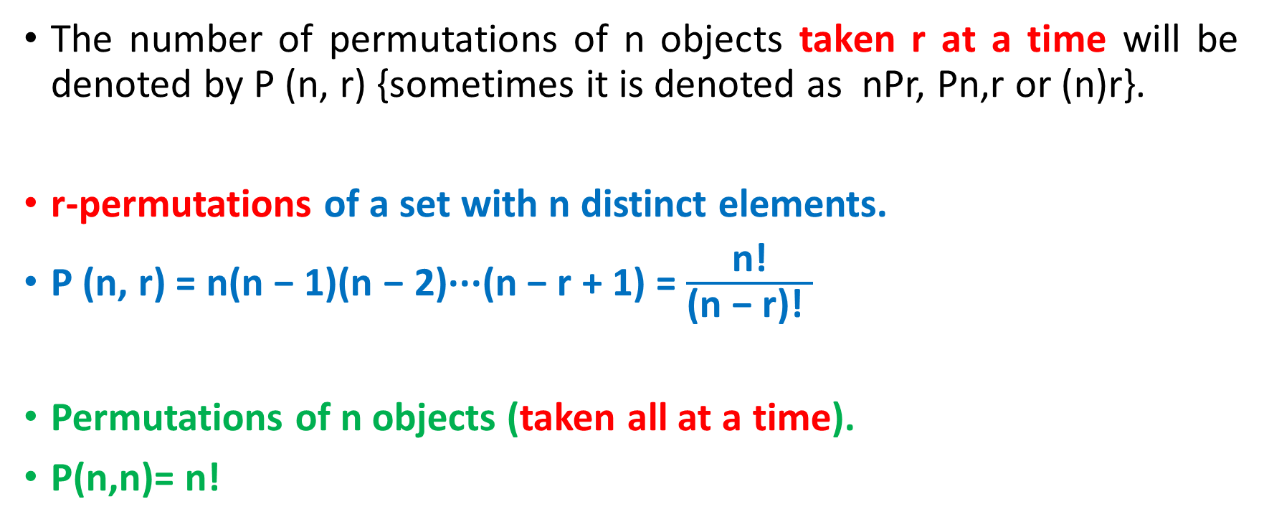
Permutation
The number of permutations of n objects taken r at a time will be denoted by P (n, r) {sometimes it is denoted as nPr, Pn,r or (n)r}.
r-permutations of a set with n distinct elements.
P (n, r) = n(n − 1)(n − 2)···(n − r + 1) = $\frac{\text{n}\text{!}}{\text{(}\text{n}\text{ − }\text{r}\text{)!} }$
Permutations of n objects (taken all at a time).
P(n,n)= n!

Slide 10
Example
Let S = {a, b, c}.
The 2-permutations of S are the ordered arrangements of 2 elements
a, b ; a, c ; b, a ; b, c ; c, a and c, b.
Consequently, there are six 2-permutations of this set with three elements.
By the product rule, it follows that P(3, 2) = 3 . 2 = 6.

Slide 11
EXAMPLE
Find the number of “three-letter words” using only the given six letters A, B, C, D, E, F, without repetition.
Solution
The ﬁrst letter can be chosen in 6 ways;
following this, the second letter can be chosen in 5 ways;
and, ﬁnally, the third letter can be chosen in 4 ways.
P(6,3) =6·5·4=120
There are 120 permutations of 6 objects taken 3 at a time.

Slide 12
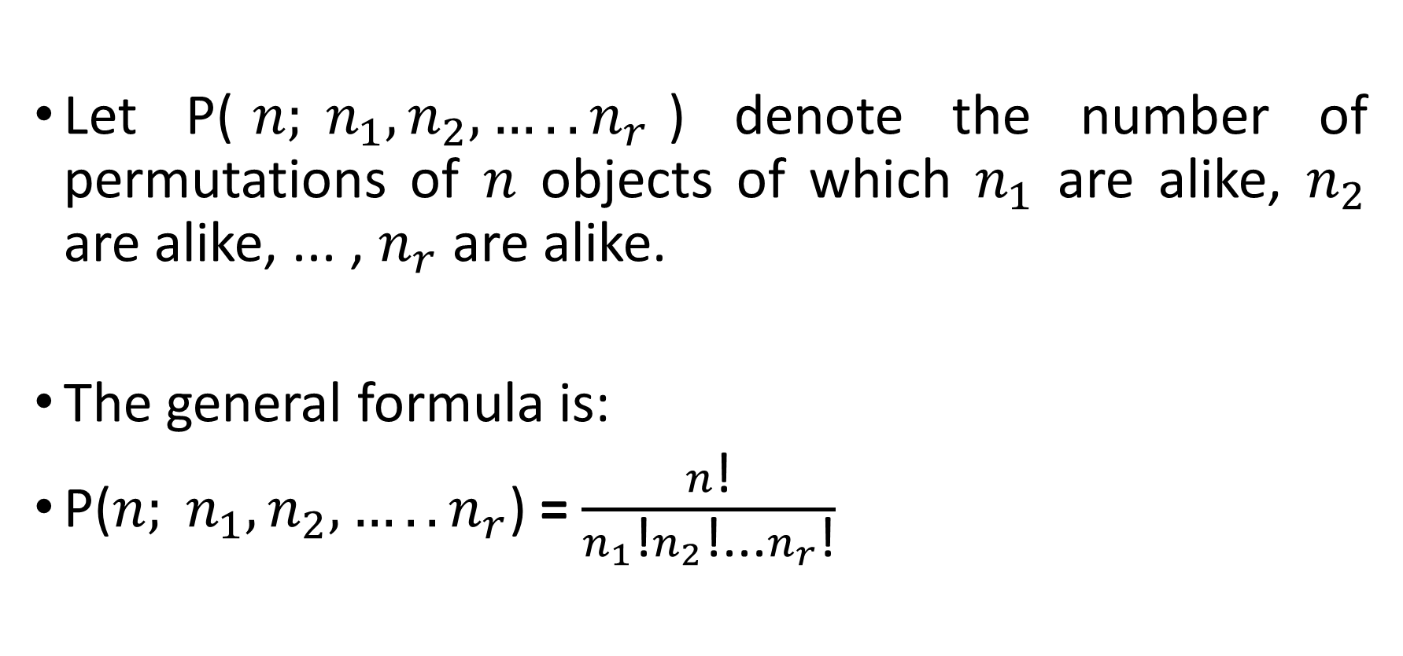
Permutations with Repetitions
Let P($n; n_{1},n_{2},{…..n}_{r}$) denote the number of permutations of $n$ objects of which $n_{1}$ are alike, $n_{2}$ are alike, ... , $n_{r}$ are alike.
The general formula is:
P($n; n_{1},n_{2},{…..n}_{r}$) = $\frac{n\text{!}}{n_{1}\text{!}n_{2}\text{!...}n_{r}\text{!}}$

Slide 13
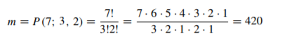
EXAMPLE
Find the number m of seven-letter words that can be formed using the letters of the word “BENZENE.”
We seek the number of permutations of 7 objects of which 3 are alike (the three E’s), and 2 are alike (the two N’s).

Slide 14
Ordered Samples
When we choose one element after another, say, r times, we call the choice an ordered sample of size r.
Example
To choose 3 cards one after the other from a 52-card deck (choice is ordered sample of size 3)
Two cases:
(1) Sampling with replacement
(2) Sampling without replacement

Slide 15
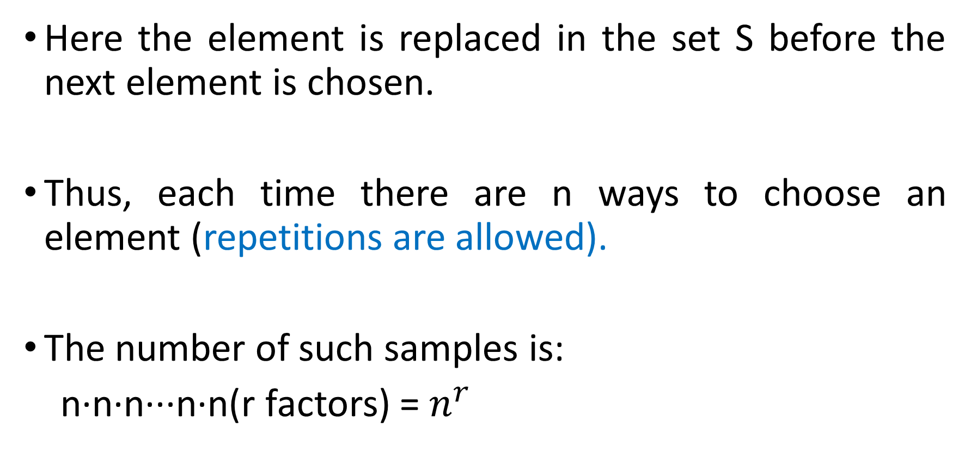
(1) Sampling with replacement
Here the element is replaced in the set S before the next element is chosen.
Thus, each time there are n ways to choose an element (repetitions are allowed).
The number of such samples is:
n·n·n···n·n(r factors) = $n^{r}$

Slide 16
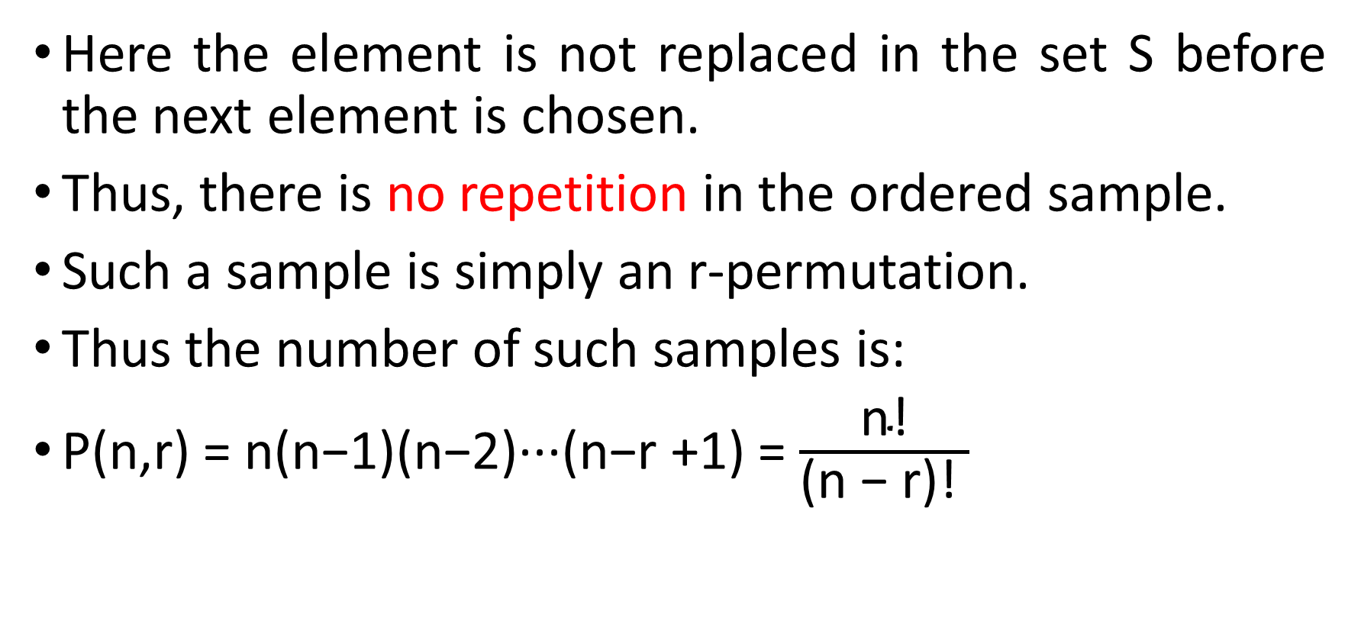
(2) Sampling without replacement
Here the element is not replaced in the set S before the next element is chosen.
Thus, there is no repetition in the ordered sample.
Such a sample is simply an r-permutation.
Thus the number of such samples is:
P(n,r) = n(n−1)(n−2)···(n−r +1) = $\frac{\text{n}\text{!}}{\text{(}\text{n}\text{ − }\text{r}\text{)!} }$

Slide 17
EXAMPLE
Three cards are chosen one after the other from a 52-card
deck. Find the number m of ways this can be done:
(a) with replacement;
(b) without replacement.
Solution
(a) Each card can be chosen in 52 ways. Thus m =52(52)(52) =140608.
(b) Here there is no replacement. Thus the ﬁrst card can be chosen in 52 ways, the second in 51 ways, and the third in 50 ways. Therefore:
m = P(52,3) =52(51)(50) =132600

Slide 18
Example
How many permutations of the letters ABCDEFGH contain the string ABC?
Solution:
Because the letters ABC must occur as a block,
we can find the answer by finding the number of permutations of six objects, namely, the block ABC and the individual letters D, E, F, G, and H.
Because these six objects can occur in any order, there are 6! = 720 permutations of the letters ABCDEFGH in which ABC occurs as a block.

Slide 19
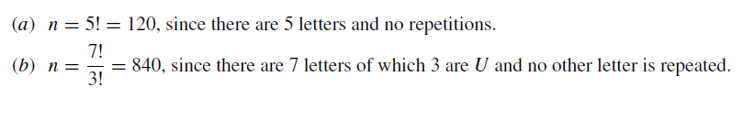
Example :
Find the number n of distinct permutations that can be formed from all the letters of each word:
(a) THOSE; (b) UNUSUAL; (c) SOCIOLOGICAL.

Slide 20
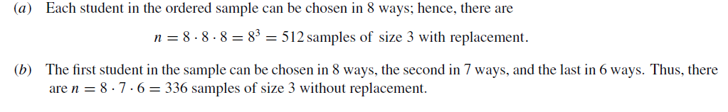
Examples
A class contains 8 students. Find the number n of samples of size 3:
(a)With replacement; (b)Without replacement.

